Slide 2
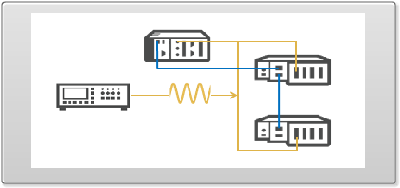
1. TSN sync between cRIO and cDAQ
cRIO-9043
TSN supported on ethernet port, connect using Port 1
NI 9233 for input, FPGA mode
Low priority - maybe change to another AI module?
cDAQ-9185
NI 9215 BNC
(b/c NI 9233 not supported in DAQmx 18.0)
Low Priority
FuncGen can be changed to 9263 AO

Slide 3
Download Code from here:
https://forums.ni.com/t5/LabVIEW-Time-Sensitive/cRIO-and-cDAQ-Synchronous-Data-Acquisition-Example/gpm-p/3641175
https://forums.ni.com/t5/LabVIEW-Time-Sensitive/cRIO-and-cDAQ-synchronous-data-acquisition/gpm-p/3709574

Slide 4
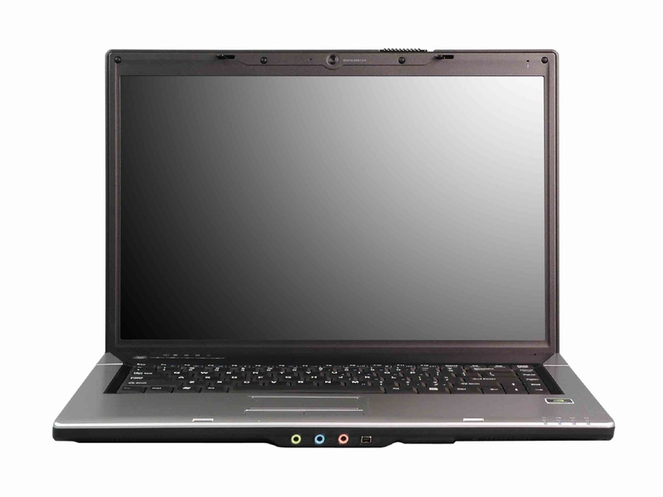
2. EPICS I/O Server communication (LV DSC)
LabVIEW EPICS I/O Server
(Connect to PC using port 0)
LabVIEW EPICS I/O Client
(maybe also 3rd party I/O Client on PC)
http://www.ni.com/white-paper/14149/en/

Slide 5





EPICS
SystemLink
TSN
Waveform Signal
https://imgur.com/a/uWLs8F2

Slide 6
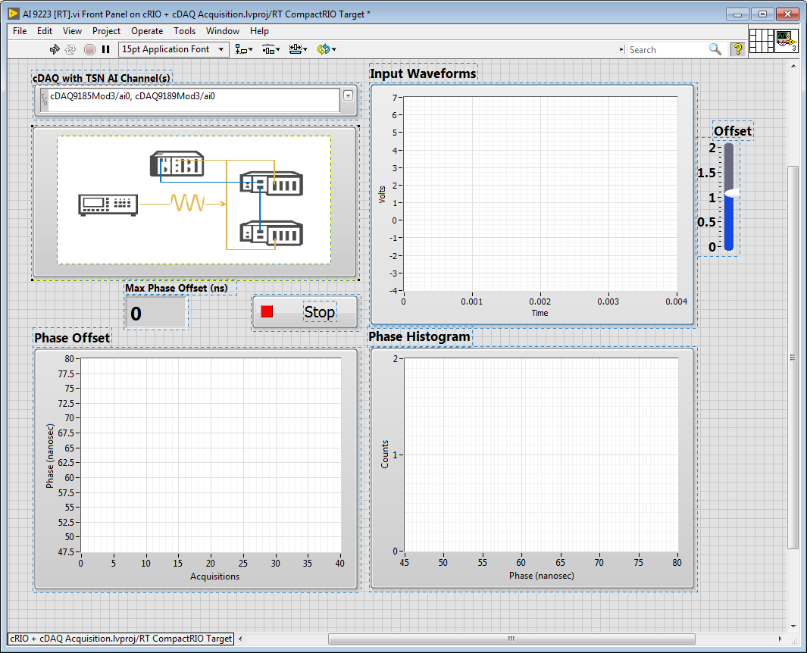
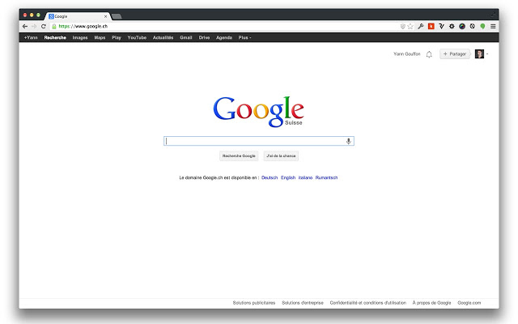
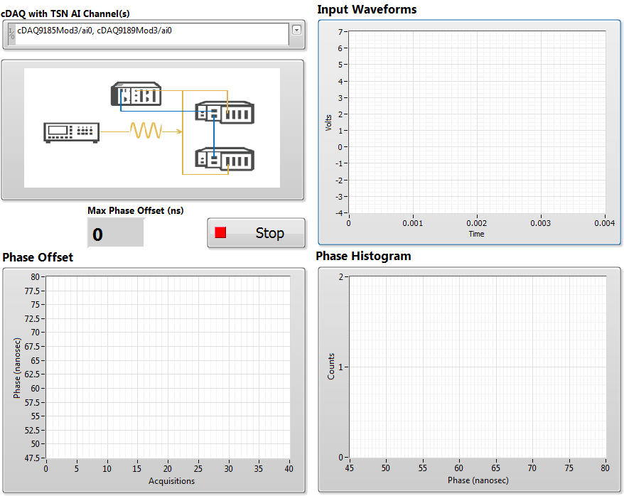
3. Web UI (Systemlink Dashboard)
Install Systemlink Server on PC

